Slide 1
Module 1 Overview of Design and Build a Data Warehouse
Lesson 2: Course topics and assignments
Notes:
Welcome to Lesson 1 of Module 1 on Design and Build a Data Warehouse for Business Intelligence Implementation
Four course sequence on data warehouse and business intelligence essentials along with a capstone project course
Fifth course providing a case study based on the business situation faced by CPI Card Group
Fun but challenging course for both business and computer science students
Learn new concepts, skills, and practices vital to careers in data warehousing and business intelligence

Slide 2
Lesson Objectives
Understand course orientation and flow
Plan for assignments and assessments
Install and configure software

Slide 3

Case Study
Realistic business situation
Larger, more complex problems
Integrate and extend concepts and skills
Notes:
Course organized around case study
CPI Card Group
Simplified and modified but realistic business situation
Larger problems

Slide 4
Course Flow
Module 2
Module 3
Business situation for data integration
Module 4
Business situation for analytical queries and materialized views
Reporting needs
Workflow extensions
Summary data requirements
Module 5
Visualization requirements
Analytical query requirements
Change data processing requirements
Business situation for dashboard and reporting
Dashboard requirements
Module 1
Course background
Organization background
Software requirements
Business situation for data warehouse design
Data source requirements
Notes:
Unit 1:
Review concepts from course 1 (motivation, characteristics, data cubes, and schema patterns)
Main topic is SQL subtotal operators
Unit 2:
Motivation and processing model for analytic functions
Basic syntax elements for SQL analytic functions
Extended analytic functions for window comparisons and quantitative ranking
Unit 3:
Usage of traditional relational views (should be review of database background)
Materialized view definition and processing
Query rewriting principles and practice
Design tools
Oracle data integration tools
Unit 4:
Data warehouse specialists: repeat of material from first course
Big data characteristics and business evaluation
Data governance concepts and processes
Units 1, 2, and 3 have assignments: self graded
Quizzes at the end of each unit
Threaded discussions in each unit
Final exam in unit 4

Slide 5
Lesson Overviews
Context for each module
Executive interviews
Case background
Perspectives from external organizations
Notes:
Lessons not directly connected to assignments
Lessons provide a general background on the case details of the module
Provide a context

Slide 6
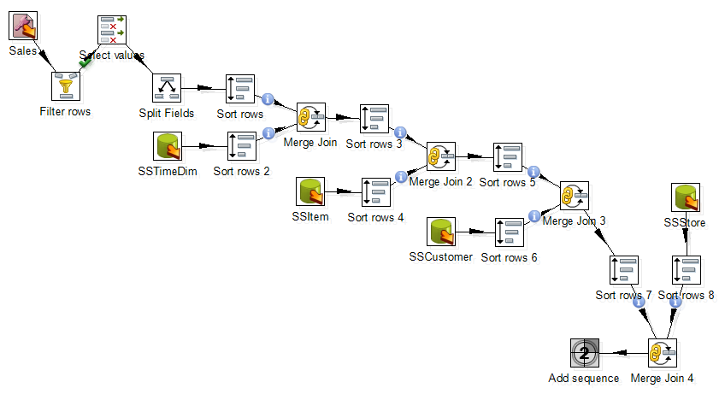
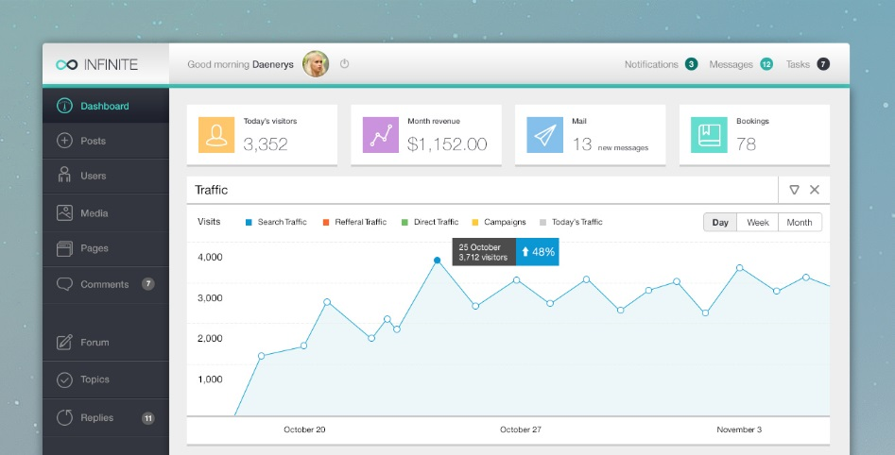
Assignments
Data source 1
Data source n
DW schema
Data integration workflows
Schema design
SELECT CustState, CustName,
SUM(SalesDollar) AS SumSales,
RANK() OVER (PARTITION BY CustState
ORDER BY SUM(SalesDollar) DESC)
SalesRank
…
Dashboard and visualizations
SQL analytical queries
Notes:
SQL analytic queries
Write SQL statements
Determine requirements for materialized views
Data integration
Change data processing
Practice rewriting using multiple materialized views
Graphic depicts matching process for materialized views and queries
Dashboard design and implementation (free image from http://victorsosea.com/blog/infinite-admin-free-psd-web-admin/)

Slide 7
Assignment Dependency
Module 2
Module 3
Module 4
Module 5
Standard DW

Slide 8


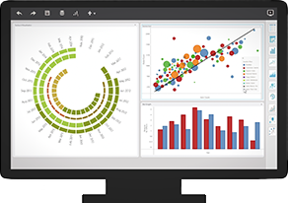


Tools
Notes:
Oracle database and SQL Developer client
- Working with small and medium size data warehouse
Pentaho Data Integration
MicroStrategy Desktop

Slide 9
Summary
Integrate and extend concepts and skills
Organized around realistic case study
Assignments based on major parts of other courses
Usage of Oracle server and client, Pentaho Data Integration, and Microstrategy Desktop
Executive interviews for organizational perspectives

